Slide 1

Introduction to the ISHI-KAI
ISHI-KAI
https://ishi-kai.org/
Mail: info@ishi-kai.org

Slide 2
Agenda
About the ISHI-KAI
Activities of the ISHI-KAI

Slide 3
About the ISHI-KAI

Slide 4
What is the ISHI-KAI?
The name was inspired by the society community (KAI is the society community in Japanese) that deals with open (democratised) ISHI(ISHI is stone in Japanese) = Silicon = Semiconductor (ASIC/LSI/IC) and connects various fields.
The pioneering OpenMPW (Open Multi Project Wafer) is a shuttle programme created by Google's investment in Efabless, which provides the tools (EDA/PDK) necessary for making semiconductors (ASIC/LSI/IC) to fab theIt is a programme that allows the manufacture of semiconductors (ASIC/LSI/IC) entirely open and free of charge, including the tools needed to make semiconductors (ASIC/LSI/IC) (EDA/PDK) to ISHI manufacturing in fabs. This is exactly what the open source movement (democratisation of software) that started with GNU is all about: open semiconductors (ASIC/LSI/IC) and EDA/PDK!
Therefore, this meeting focuses not only on conventional semiconductor (ASIC/LSI/IC) experts, but also on those who see the potential in the future open source movement of semiconductors (ASIC/LSI/IC) and those who want to create new semiconductors (ASIC/LSI/IC).It was set up as a user society community.
Just as operating systems, compilers, libraries, apps, electronic boards, 3D CAD and 3D printers that were only available to specialists are now available to everyone as open source software, open hardware, open modelling, etc., so semiconductors (ASIC/LSI/IC) and EDA/PDKs are now available to everyone.
The policy for future activities is to revolutionise the semiconductor (ASIC/LSI/IC) field by involving people from other fields, and we will organise events such as hands-on seminars for very beginners for other fields and study groups with dense content for experts, and we will form teams to organise OpenMPW shuttles and globalChipathon challenges and participation in events such as the Maker Faire, so please do get in touch.
Community to support beginners
(those outside the semiconductor industry)
who want to make semiconductors.
Notes:
読ませる気はない。
医師会じゃないよ！

Slide 5

Making 'I have made it' To create a "Make: Movement (open hardware)" level big wave in open source semiconductors.
Companies that started up in Make: Era
From software companies and others with no connection to hardware, something like an 'in-house Make:Development Department' was set up and derived from it.
'Where have you acquired your knowledge?'
Open hardware communities in the Make:
'A coherent number of technicians were created'
Any company can now do business involving hardware.
'Make it work as a business'
'Intermediaries with knowledge of both the industry and business of the party wishing to enter and the semiconductor industry' are needed.

Slide 6
Grand Design of ISHI-KAI
Chip in with Everyone’s Experience!
I want to develop new sectors but don't know how to do it
Want to convert to ASIC (LSI) but have no information
Current state of the ASIC (LSI) industry (stagnation)
Cannot Share because of NDAs.
Cutting Edge Requires Big Money
Young people are not coming in.
Current situation in other industries (sense of limitation)
Demand for high speed, compactness and power saving
Limitations with generic chips + software
OpenMPW to the market!!
Everything is open!
Significance of the community
Re-use of results possible; Do It With Others mentality
Advantages of Japan: geographical location makes it physically easy to get together and hold study groups and camps.
Significance of ISHI-KAI
Expectations for unprecedented research and development through the integration of knowledge from other (multi)disciplines
Notes:
なんでこんなことになったのか？というと・・・
ラピダスさんとか話題ですけど、OSSの人間として、別のアプローチで半導体の世界を変えたい！ってことです。
ってことでやっているのが、ISHI会です。

Slide 7
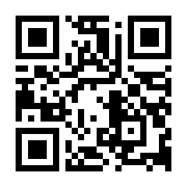
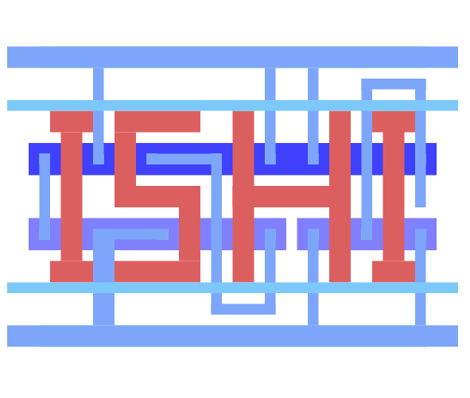
Information on the ISHI-KAI
Number of members
350 or more
Homepage
https://ishi-kai.org/
Active on Discord
https://discord.gg/RwAWF5mZSR
Event announcements (e.g., workshops)
https://ishikai.connpass.com/
About 20-50 people attend at any given time

Slide 8
Activities of the ISHI-KAI

Slide 9
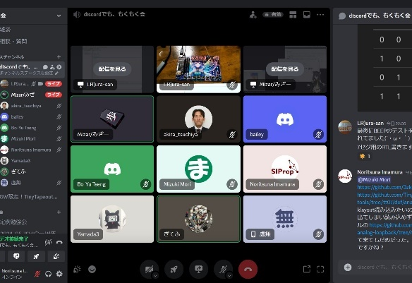
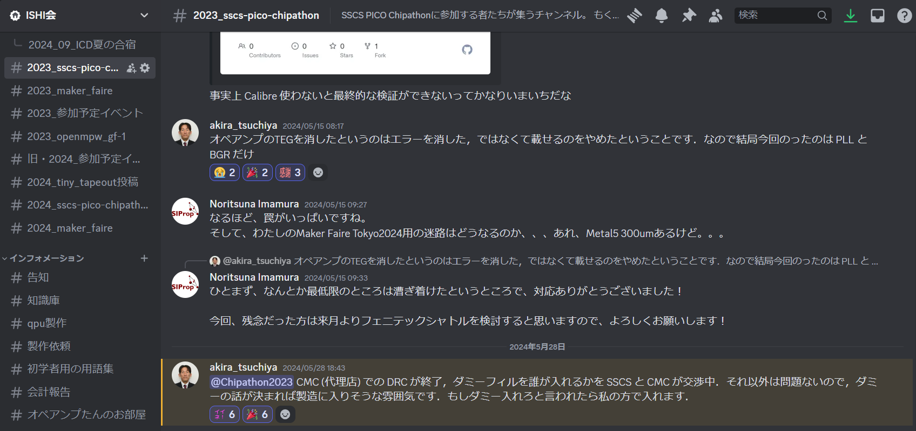
Location: Discord
Base of operations on the Internet
Using Discord, a chat application
Equivalent to an office in a typical organization
Main Activities
Discussion by each channel on the theme
Regular Mokumoku-kai using video chat
Mokumoku-kai: Meetings where everyone gathers in one place to develop their own themes in silence.

Slide 10
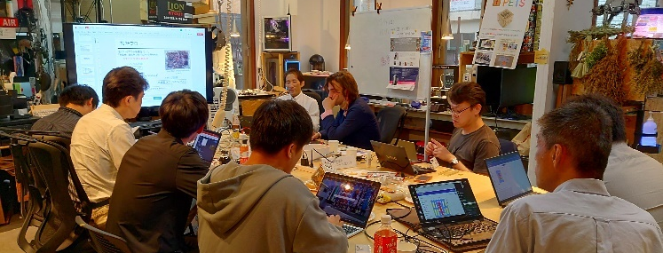
First Event
ISHI-KAI was established with the First Hands-On Seminar held on May 7, 2023.
13 members

Slide 11
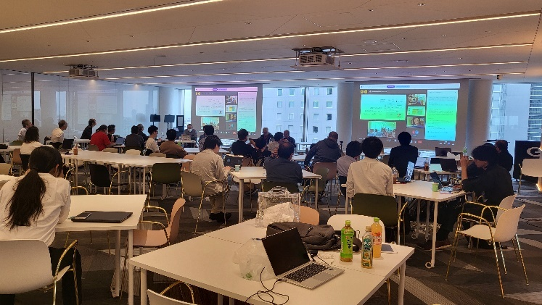

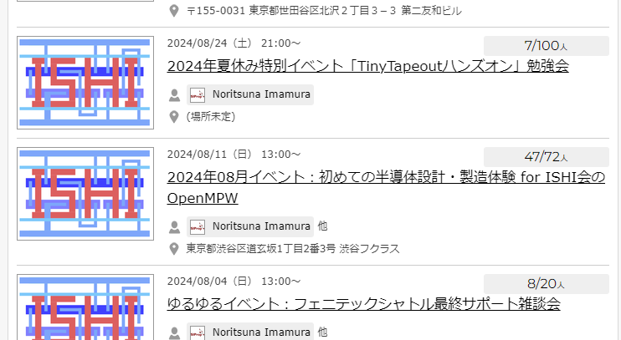
Regular Events
One of the activities for external
Once or twice a month, we hold study sessions and hands-on seminars for beginners by inviting guest lecturers on the theme.

Slide 12
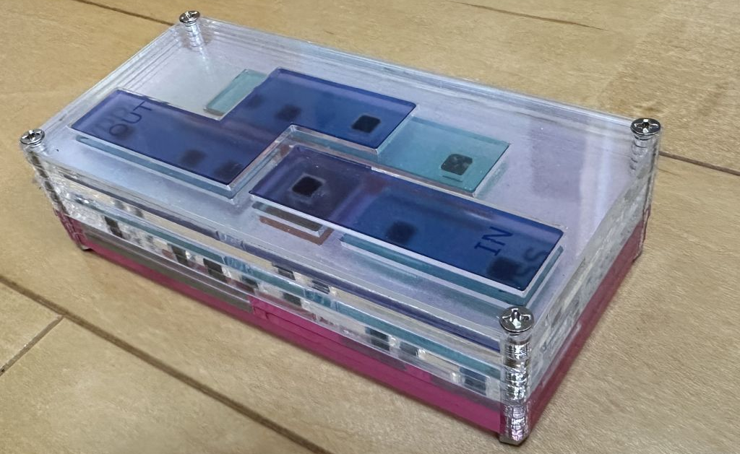
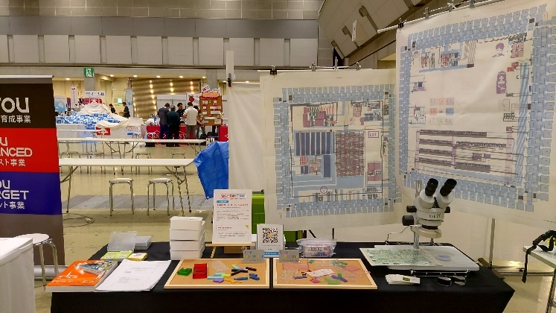
Exhibition: Maker Faire
Exhibit at Maker Faire Tokyo 2023

Slide 13
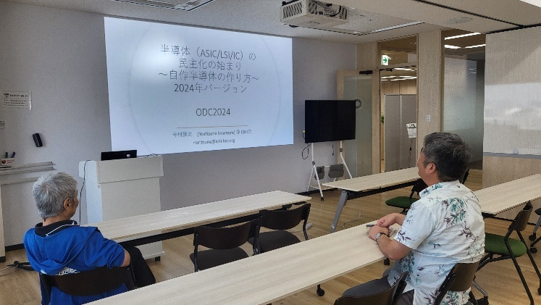
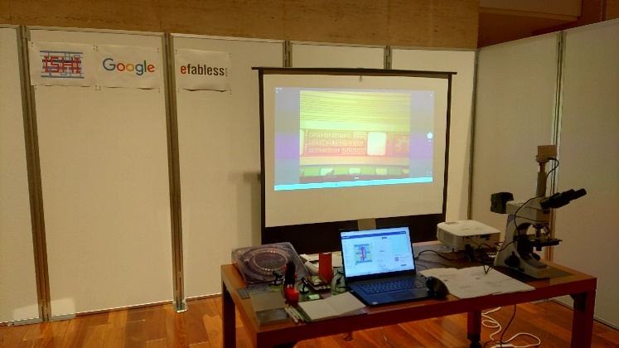
Exhibition
Community Events/Exhibitions
Industry Events/Exhibitions

Slide 14
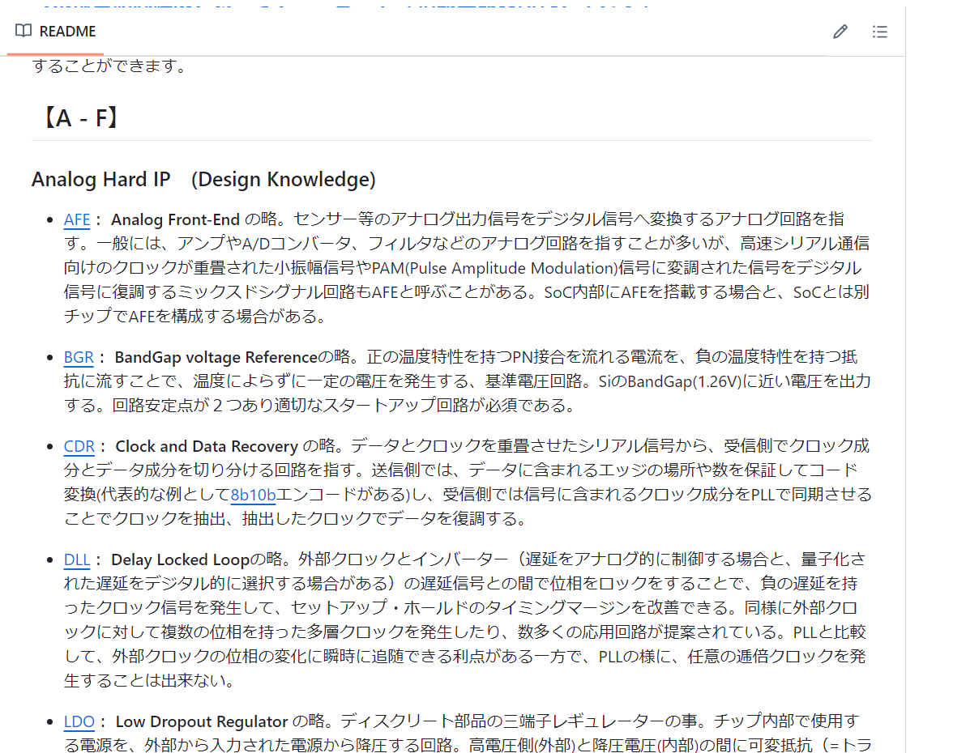
Other Cooperation
VLSI.jp
Documentation of various hands-on findings related to open source silicon
Production of "Glossary of Terms Used in Semiconductor Design" for beginners of semiconductor design.

Slide 15
Shuttle Submissions

Slide 16
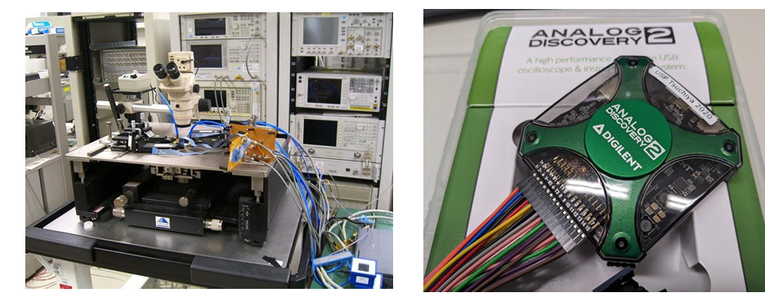
Prof. Tsuchiya called for the formation of a Japanese team
Chipathon2023
Notes:
今年の目標は、大きく、AnalogDiscovery2をチップ化しちゃいましょうという目標。
これを機能単位で、各チームが作っていく感じです。

Slide 17
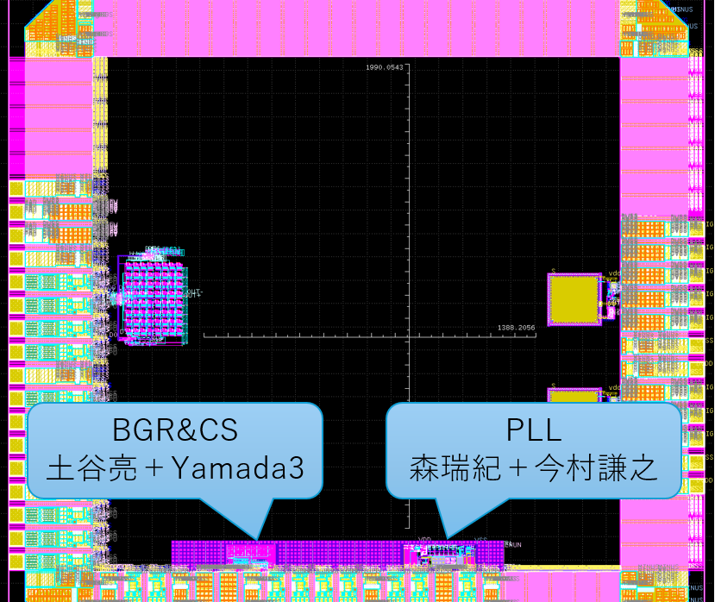
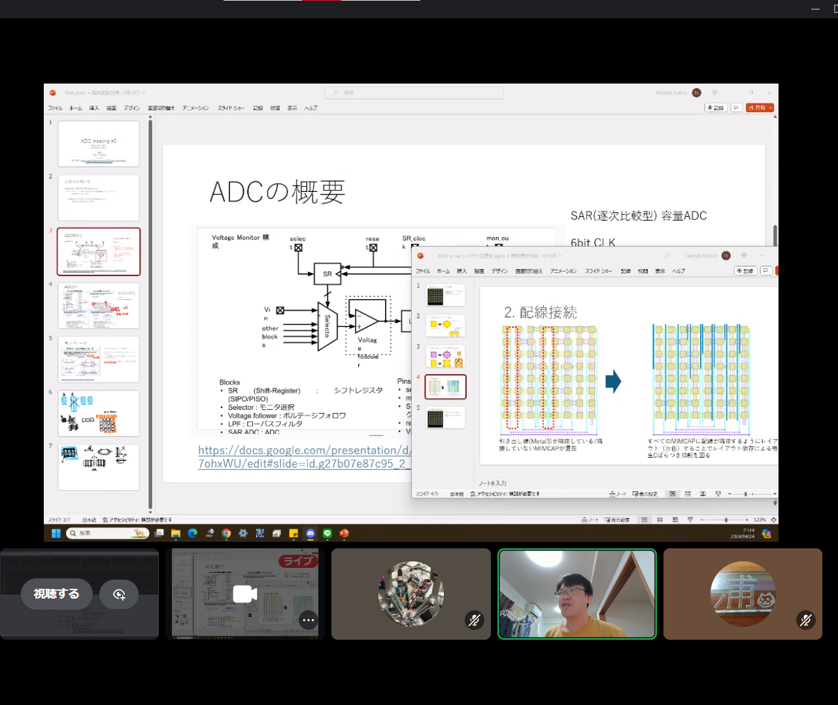
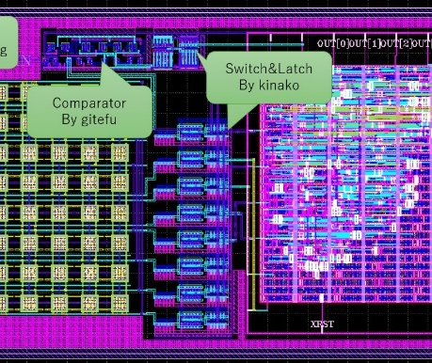
Chipathon2023 Results
BGR+CS Group
Prof.Tsuchiya & Yamada3
PLL Group
Mori & Noritsuna
ADC Group
Led by Prof. Kuboki, 4 young CS undergraduates and young people working in hardware companies

Slide 18
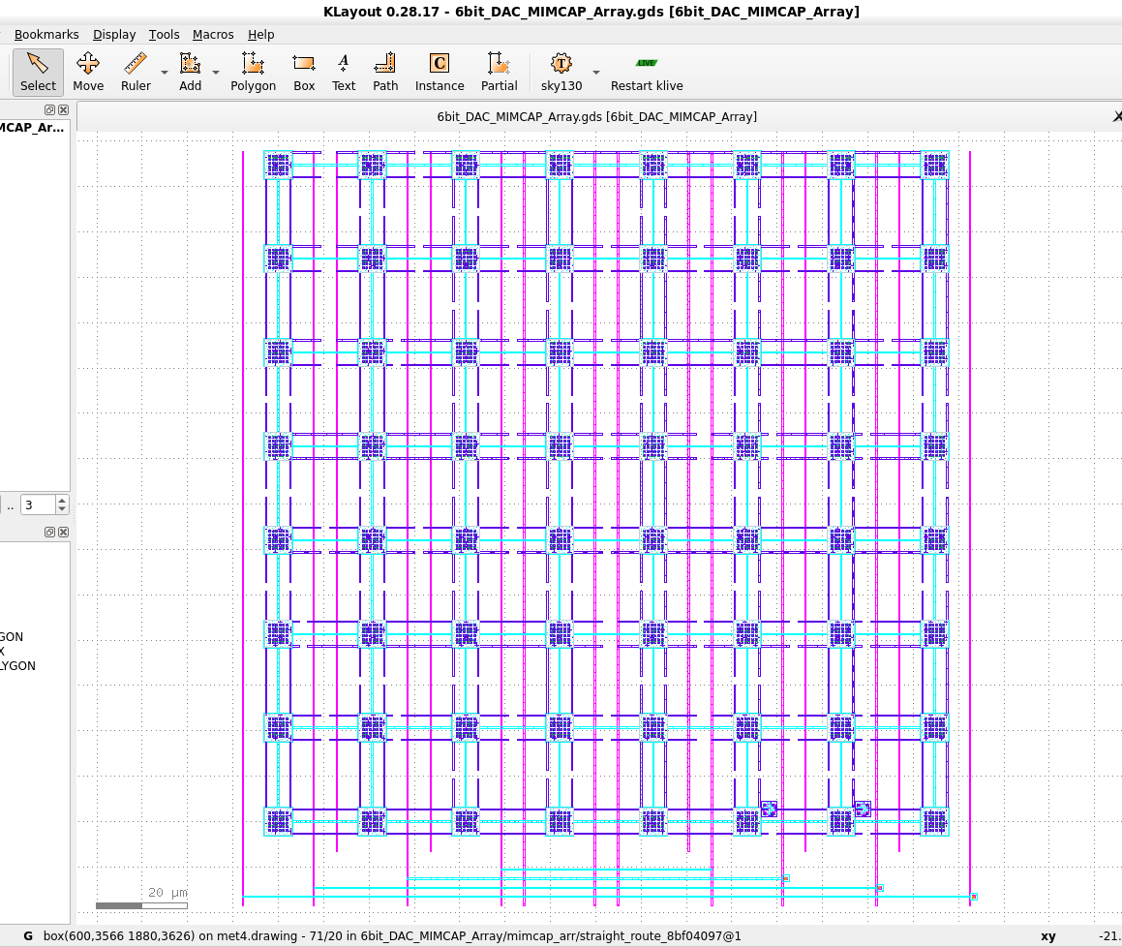
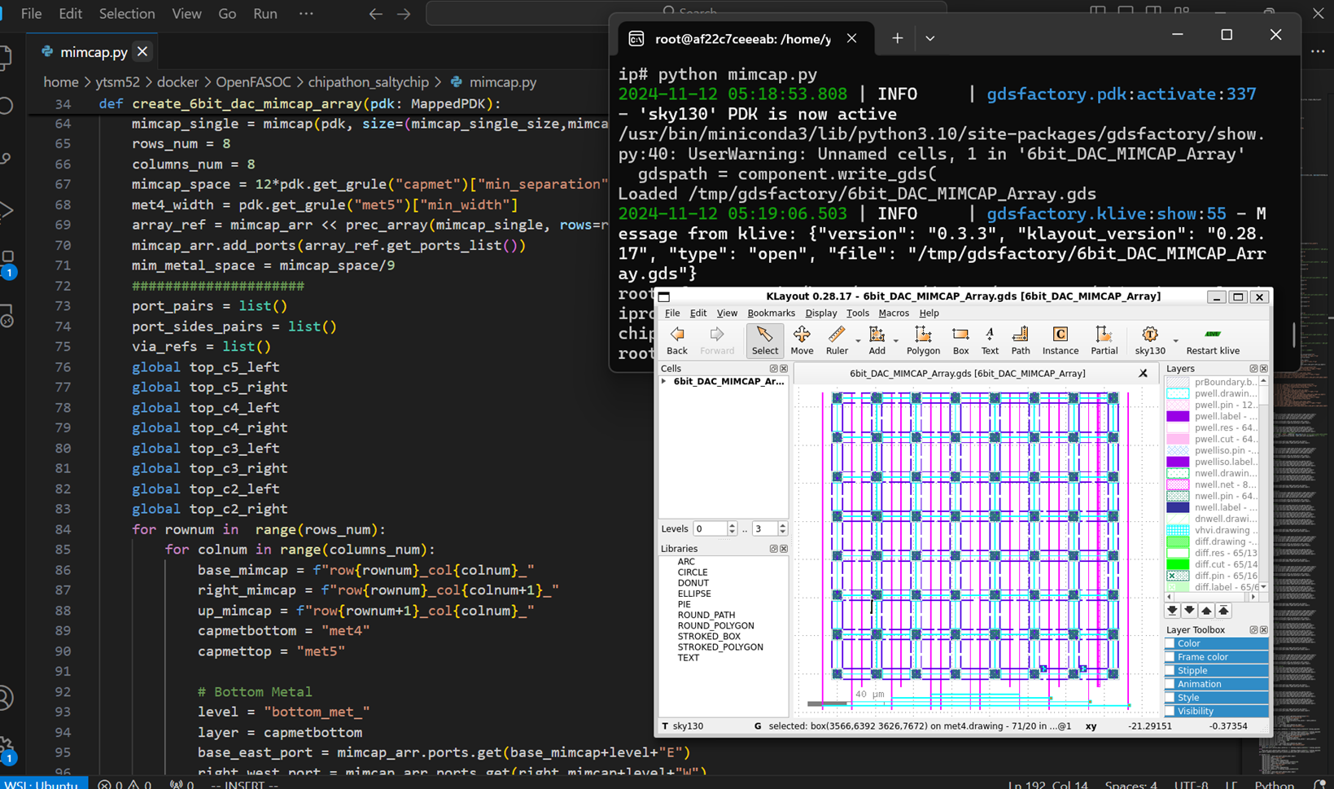
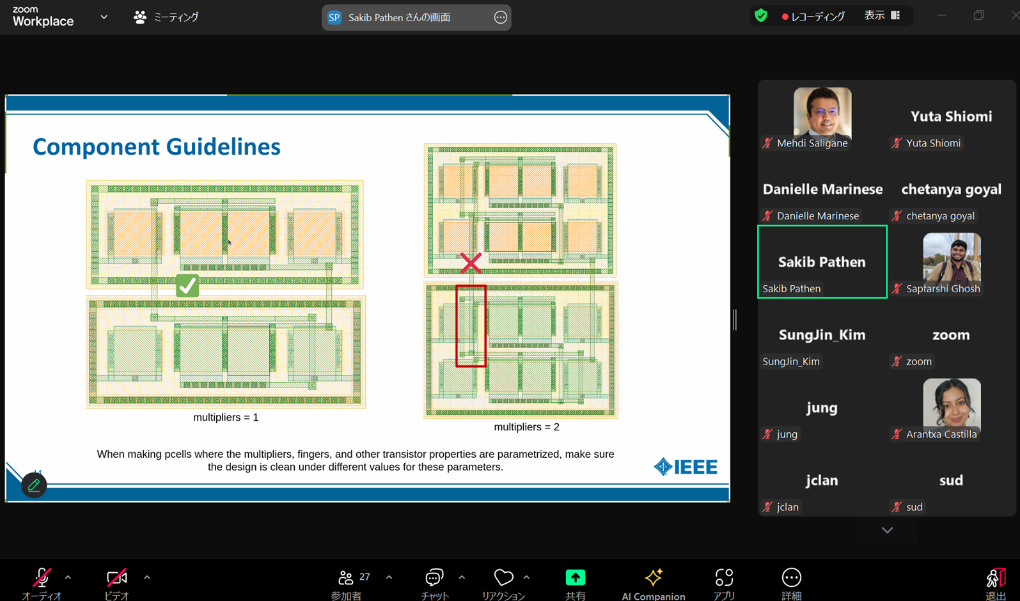
Chipathon2024 Result： SaltyChip Team
DAC
Submitted!

Slide 19
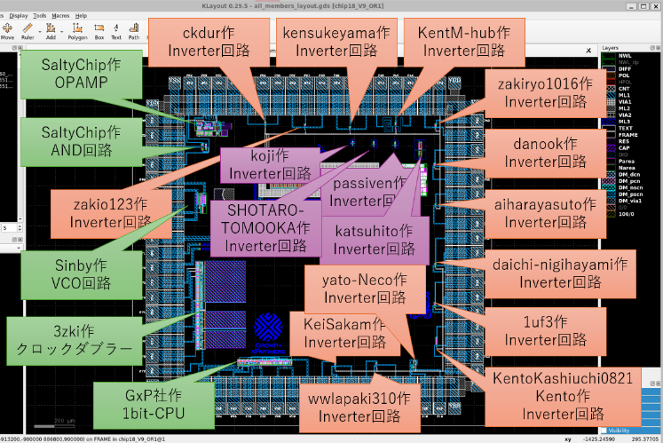
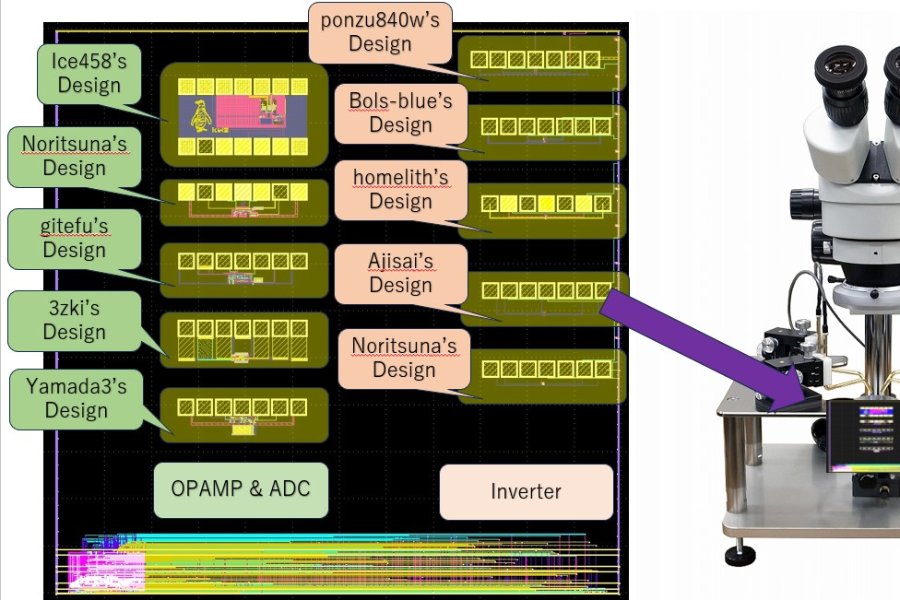
Sharing a Shuttle
Support for multiple users to share a shuttle
Hands-on seminars for beginners
Team Submissions

Slide 20
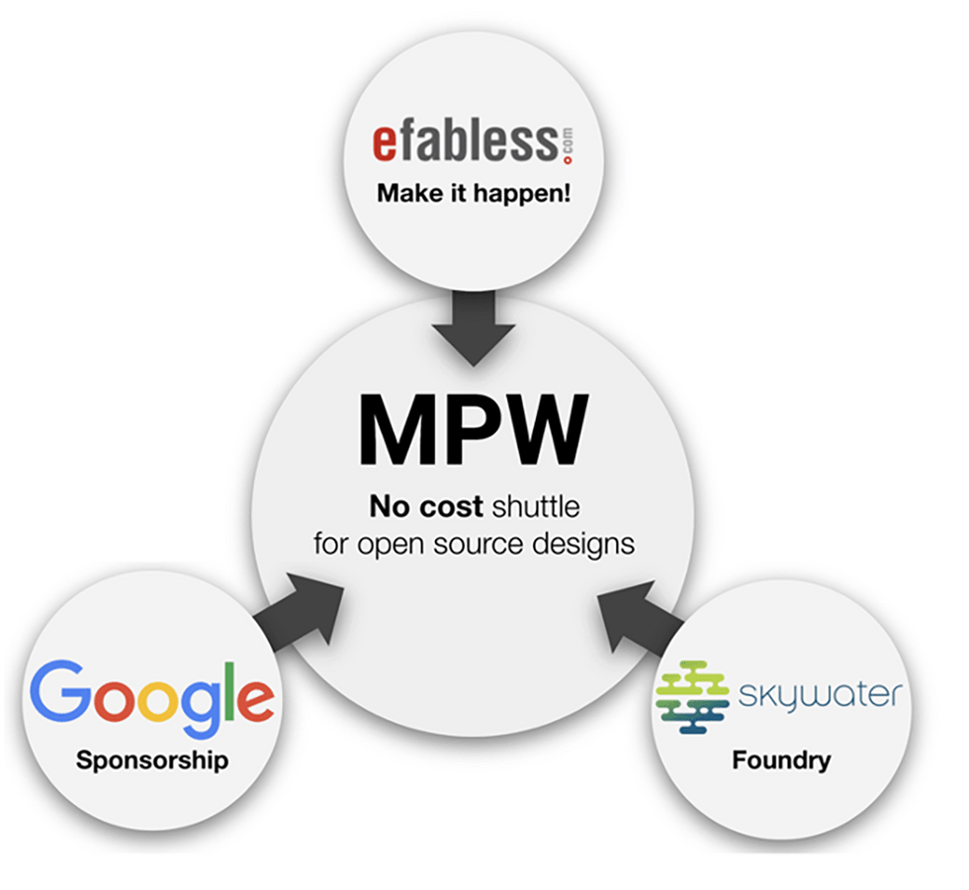




ISHI-KAI’s OpenMPW！
Community
eFabless ⇔ ISHI-KAI
Sponsor
Google ⇔ GxP
Fab
SkywaterPDK ⇔ OpenRule1umPDK
Hosting as ISHI-KAI’s OpenMPW-PTC06-1

Slide 21
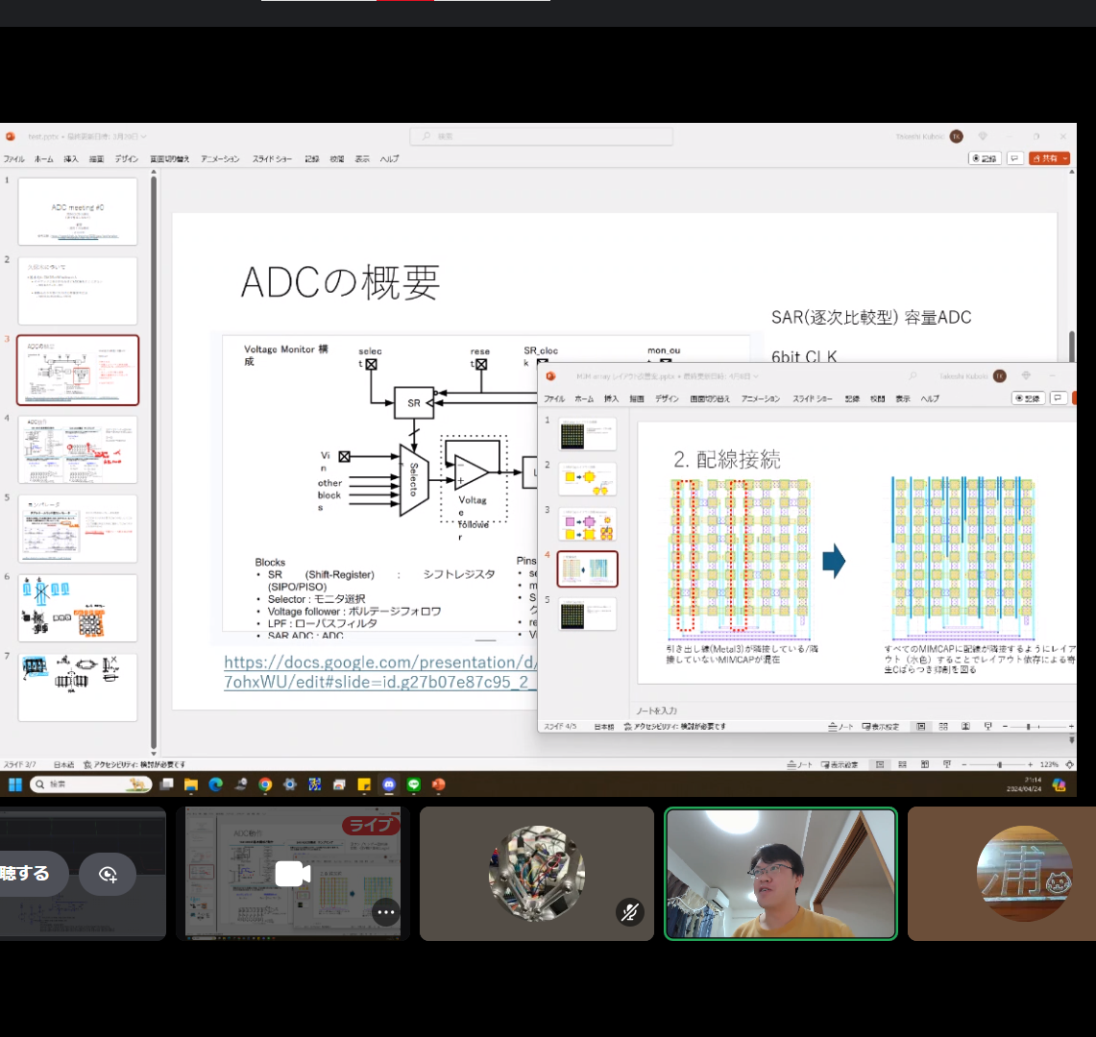
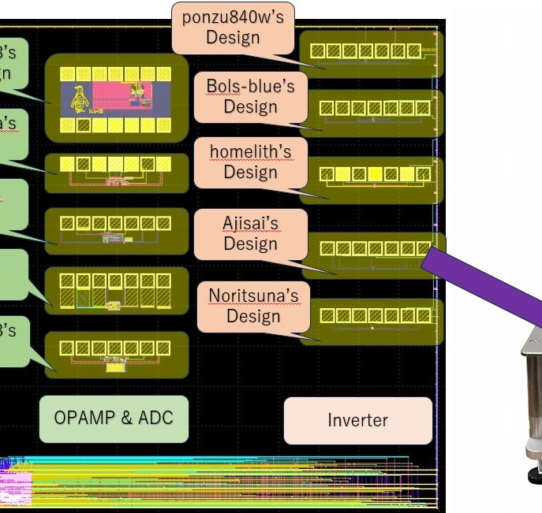
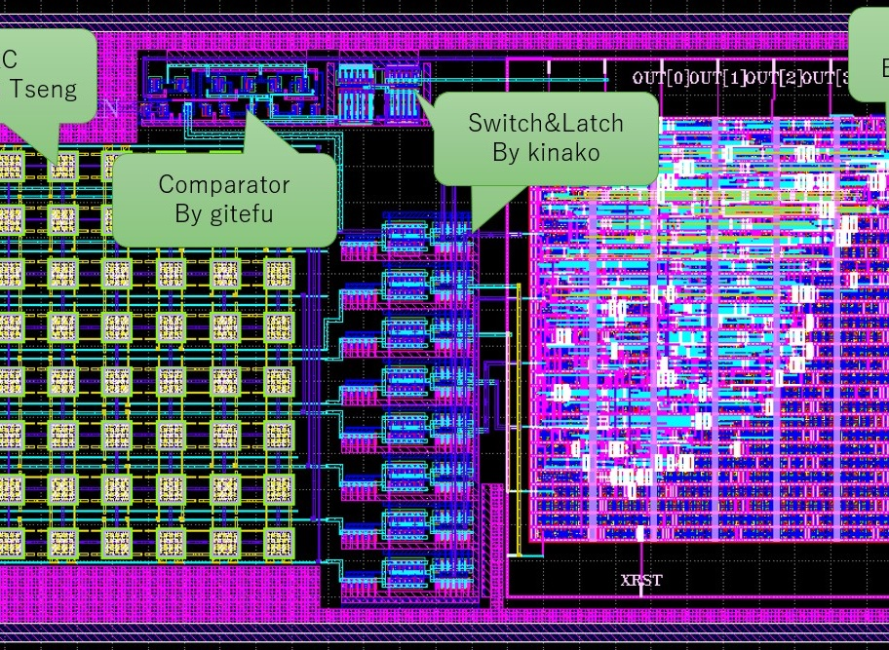
Shuttle: ISHI-KAI Share Results
2023/12
OpenMPW GF-1
https://github.com/ishi-kai/ISHI-KAI_Multiple_Projects_OpenGFMPW-1/
2024/05
Chipathon2023
https://github.com/ishi-kai/Chipathon2023_ADC/tree/main/submit_version
https://github.com/atuchiya/DC23-LTC2/tree/japan-test/TOP
2024/08
ISHI-KAI’s OpenMPW PTC06-1(Phenitec)
https://github.com/ishi-kai/ISHI-KAI_Multiple_Projects_OpenMPW_PTC06-1
2024/10
ISHI-KAI’s OpenMPW TR10-1(Tokairika)
https://github.com/ishi-kai/ISHI-KAI_Multiple_Projects_OpenMPW_TR10-1
2024/12
ISHI-KAI’s OpenMPW MF20-1(minimalfab)
https://github.com/ishi-kai/ISHI-KAI_Multiple_Projects_OpenMPW_MF20-1

Slide 22
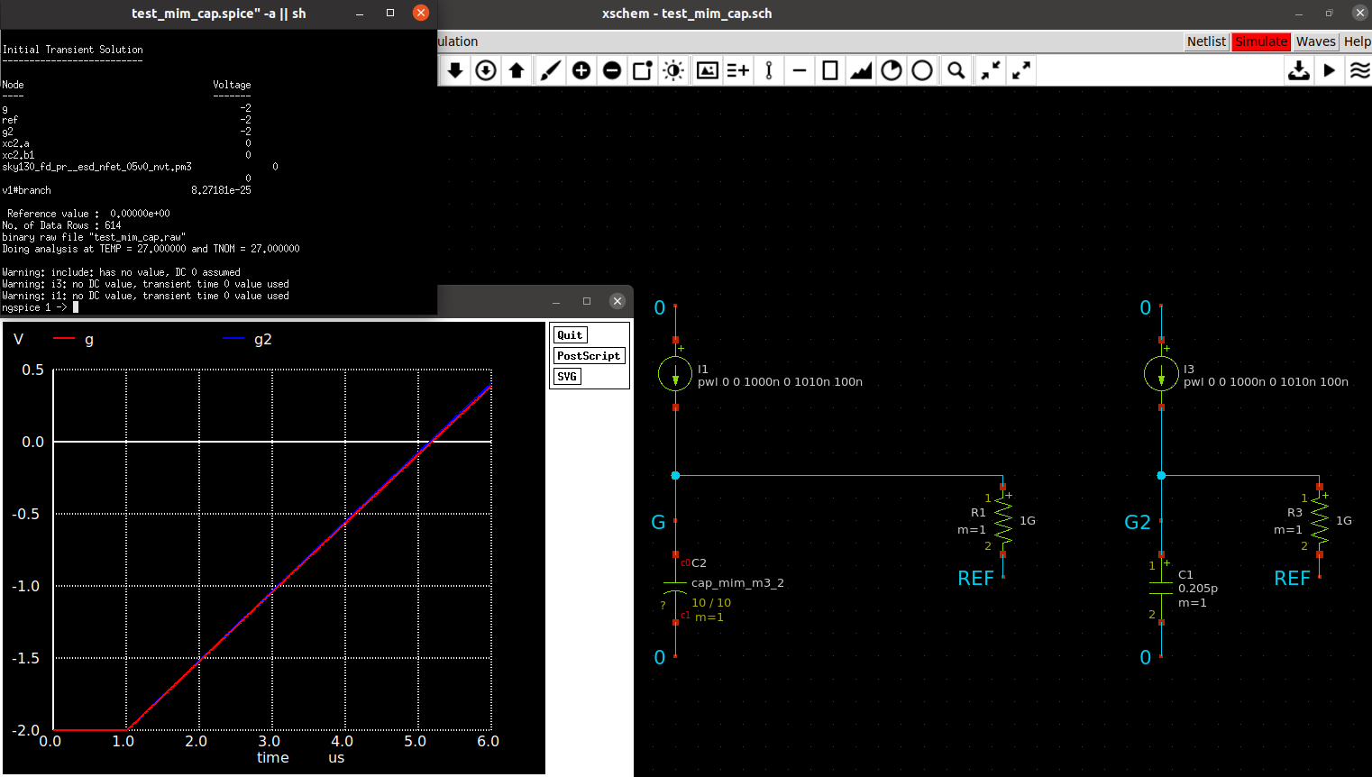
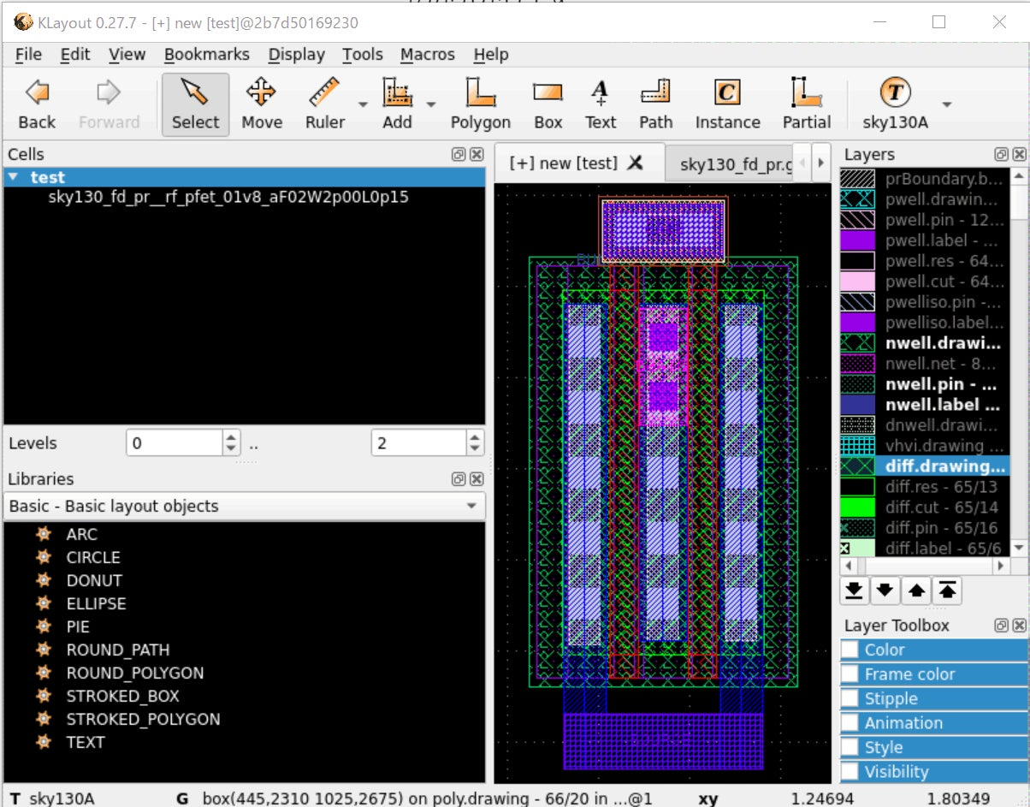
Hands-on Seminar
Learn all the basics of
semiconductor design from zero knowledge!
Hands-on seminar on the simplest inverter circuit
Circuit Design with Xschem
Working with combinations of transistors to achieve a function
Circuit Characteristics Simulation with NGspice
Work to verify that the above circuits work properly
Layout by klayout
Layout of transistors on actual semiconductors
Maker's voice
The chip design experience was very technically stimulating.
Semiconductors were completely unknown to me,
but understanding them gave me new insights.

Slide 23
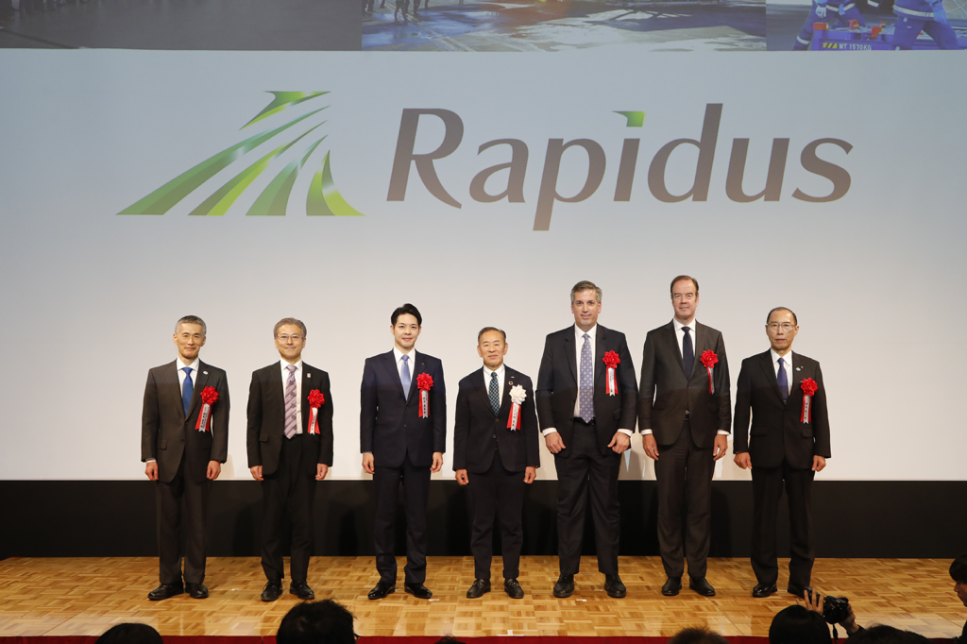
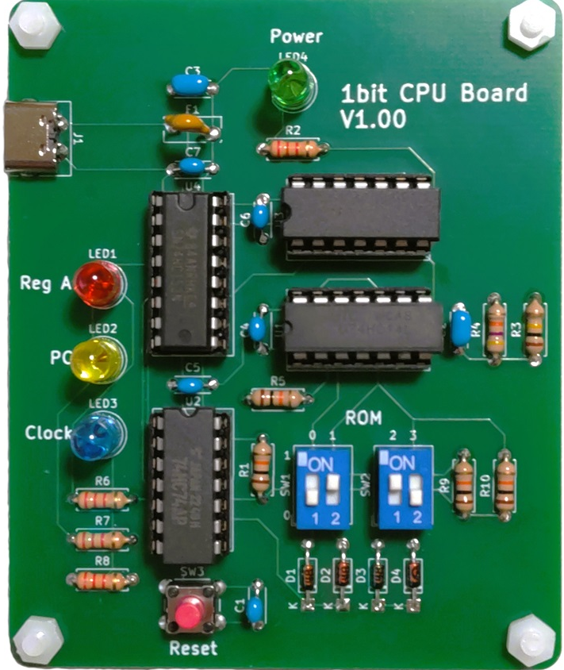
Hands-on Seminar: Target
The goal is to provide the first "hands-on" semiconductor design experience
=Increase the number of semiconductor designers within software and hardware companies
Motivation of Makers
I've been hearing a lot about semiconductors, and I'd like to know more about them specifically!
Basic knowledge of semiconductors
Semiconductor factory process details
I want to know more about how computers work!
Perhaps because even the compiler level has been covered up, a return to a more principled approach is taking place.

Slide 24
Team Submissions
Content
Have multiple people create one theme (circuit)
Leader
Have an intermediate or advanced person lead the team.
Members
Beginners design and layout with the help of a leader.
Target
Leader
Gain the ability to serve as a bridge resource for software and hardware companies seeking to create their own chips
Members
Soloing is difficult unless you are at least intermediate level, but the ISHI-KAI's main demographic is beginners. This makes it possible for many people to participate.

Slide 25
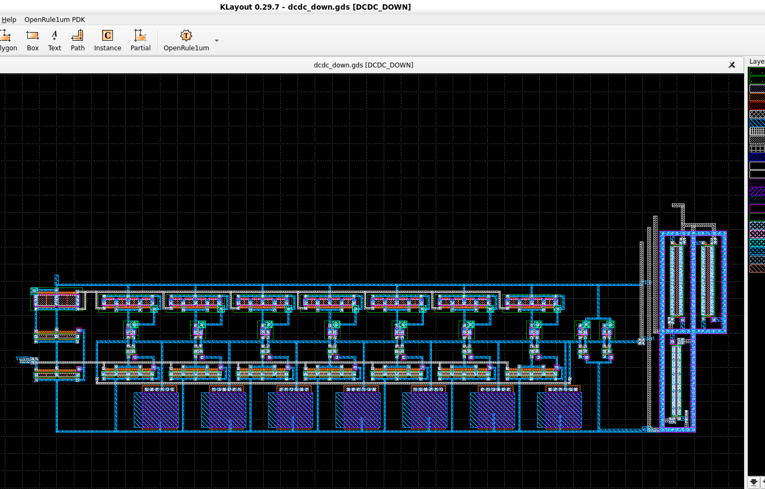
Ex: Tokairika Shuttle
Details of implementation
Create "two teams" of two types of DCDC,
a boosting DCDC and a bucking DCDC.
5V->12V, 12V->5V
Rules
Use OpenRule1um
https://github.com/ishi-kai/OpenRule1umPDK_setupEDA
Max size is "1000um(1mm) x 1000um(1mm)
Pin count is "7-pin".
VDD, input voltage pin, and output voltage pin are required.
You are free to use the later 4 pins however you like.

Slide 26
Information on the ISHI-KAI
Number of members
350 or more
Homepage
https://ishi-kai.org/
Active on Discord
https://discord.gg/RwAWF5mZSR
Event announcements (e.g., workshops)
https://ishikai.connpass.com/
About 20-50 people attend at any given time

